Slide 1
Project 1: data fusion with change of support Package, Simulation, Sampling
Ana Couto¹, Fergus Chadwick¹, David Miller^{1,2}, Jackie Potts¹, Thomas Cornulier¹
1
2

Slide 2
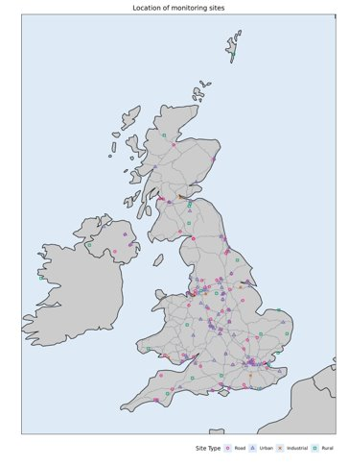
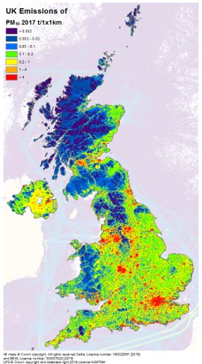
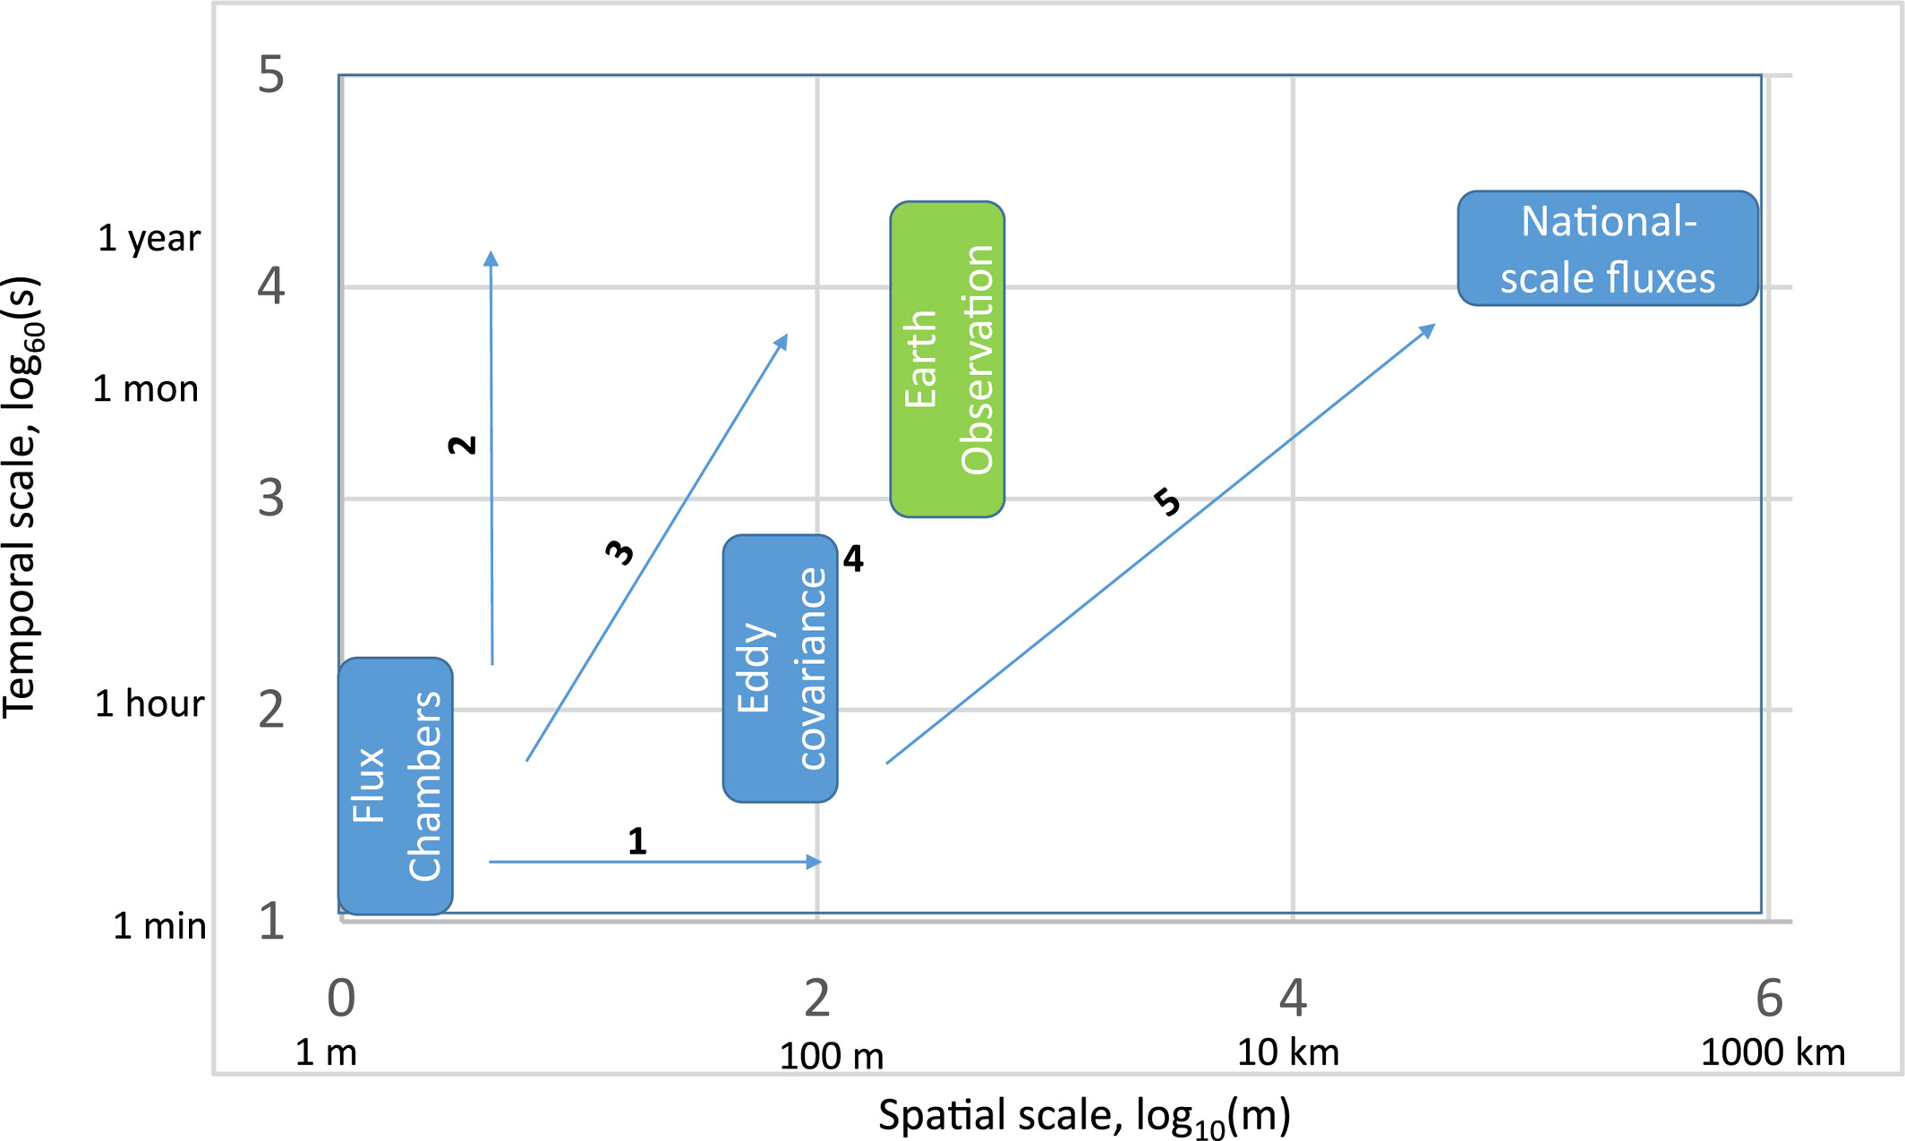
Case studies
Atmospheric pollutants
Greenhouse Gas Fluxes
(Levy et al., 2022)

Slide 3
Case studies
Atmospheric pollutants
Greenhouse Gas Fluxes
Point data
Point data
(Levy et all., 2022)

Slide 4
Case studies
Atmospheric pollutants
Greenhouse Gas Fluxes
Point data
Areal data
Areal data
Point data
(Levy et all., 2022)

Slide 5
Generalising the case studies​
Two data sources for each underlying process – point and area
(Spatio-)temporal smoothness
Sparse point sampling
No gold-standard/TruthTM.

Slide 6
Generalising the case studies​
Two data sources for each underlying process – point and area
(Spatio-)temporal smoothness
Sparse point sampling
No gold-standard/TruthTM.
https://www.nytimes.com/explain/2023/birds-science

Slide 7
What we did
Wrote a software package to simulate a wide range of systems and sampling strategies (including air pollution and greenhouse gas patterns);
Provided a suite of methods for integrating and comparing sparse spacetime data sources;
Developing guidelines for interrogating and interpreting these models.

Slide 8
What we did
Wrote a software package to simulate a wide range of systems and sampling strategies (including air pollution and greenhouse gas patterns);
Provided a suite of methods for integrating and comparing sparse spacetime data sources;
Developing guidelines for interrogating and interpreting these models.

Slide 9
ASCOT R package
By simulating the data, you know the “truth” behind the system. This can be useful to:
Check model performance under one or more scenarios
Check number of samples required
install.packages("devtools")
devtools::install_git("https://gitlab.bioss.ac.uk/ukceh-bioss-framework/dev/ascot.git", dependencies = TRUE )

Slide 10
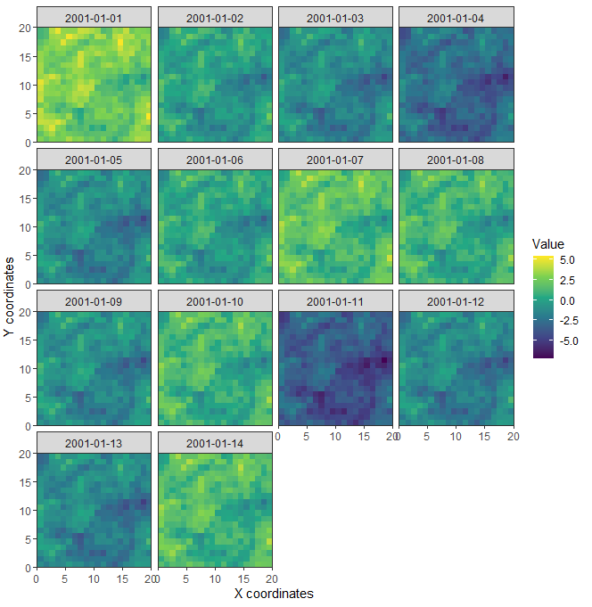
Simulating the “truth”
Temporal component
Spatial component

Slide 11
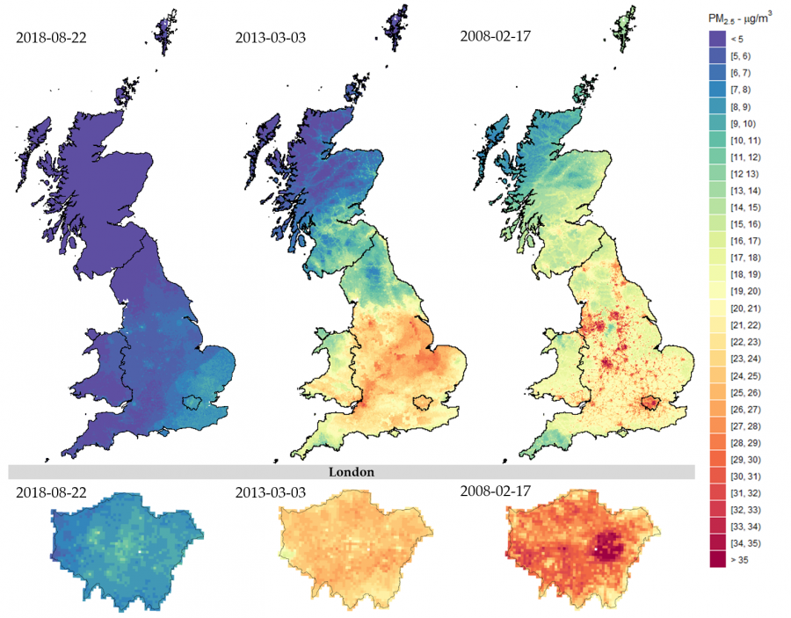
Simulating the “truth”
Temporal component
Spatial component
Day specific PM2.5 estimations across Great Britain (top) and London (bottom) (Schneider et al., 2020)

Slide 12
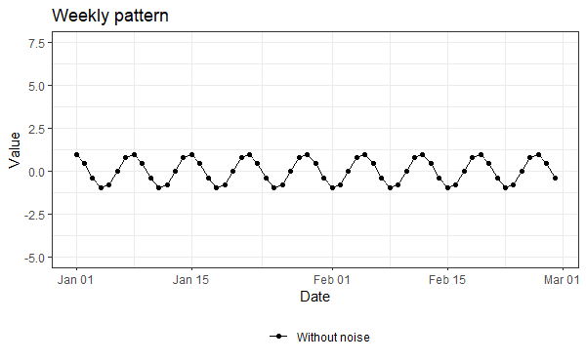
Simulate temporal data
# Create a time series time_period <-set_timeline(2, "month") # Set week pattern without noise time_series<- define_pattern_t(time_series= time_period , weekly_amplitude = 1, weekly_noise = 0, seasonal_amplitude = 0, seasonal_noise = 0, annual_amplitude = 0, annual_noise = 0)

Slide 13
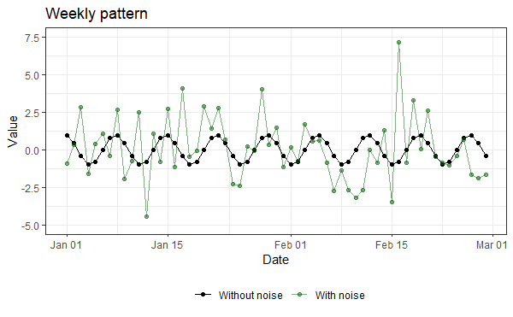
Simulate temporal data
# Create a time series time_period<-set_timeline(2, "month") # Set week pattern without noise time_series<- define_pattern_t(time_series= weekly_time, weekly_amplitude = 1, weekly_noise = 2, seasonal_amplitude = 0, seasonal_noise = 0, annual_amplitude = 0, annual_noise = 0)

Slide 14
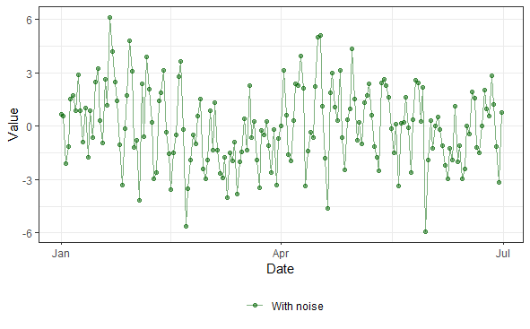
Simulate temporal data
# Create a time series time_period<-set_timeline(6, "month") # Set week pattern without noise time_series <- define_pattern_t(time_series= time_period, weekly_amplitude = 1, weekly_noise = 2, seasonal_amplitude = 1, seasonal_noise = 1, annual_amplitude = 0, annual_noise = 0)

Slide 15
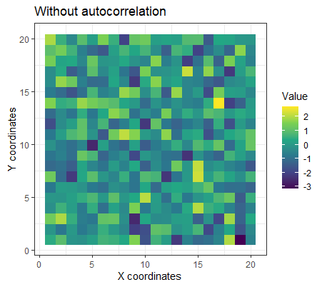
Simulate spatial data
# Create spatial field spatial_field <- define_pattern_s(n_x = 20,
n_y = 20,
autocorr = FALSE)

Slide 16
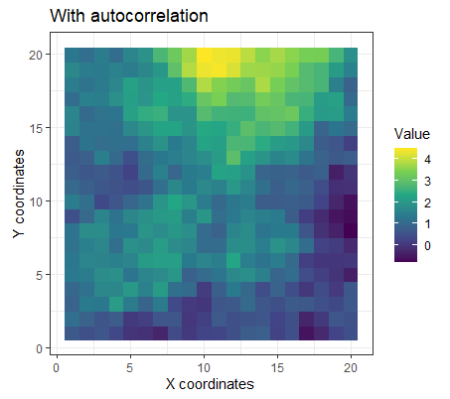
Simulate spatial data
# Create spatial field spatial_field <- define_pattern_s(n_x = 20,
n_y = 20,
autocorr = TRUE,
range = 10,
amplitude = 1)
Notes:
In more details, range corresponds to the distance at which spatial autocorrelation stops or becomes highly variable and amplitude represents the variance.

Slide 17
Simulate spatio-temporal data
truth <- simulate_spacetime(temporal_pattern = time_series, field = spatial_field, pattern_adherence = 0)

Slide 18
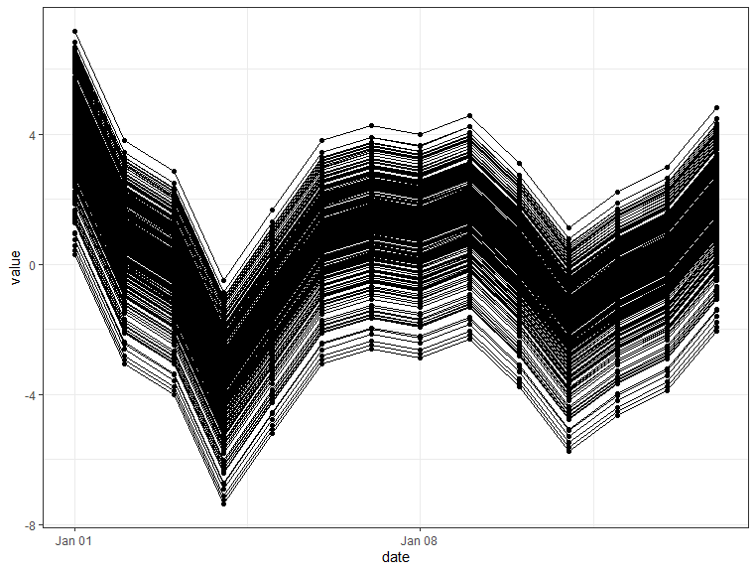
Simulate spatio-temporal data
truth <- simulate_spacetime(temporal_pattern = time_series, field = spatial_field, pattern_adherence = 0)

Slide 19
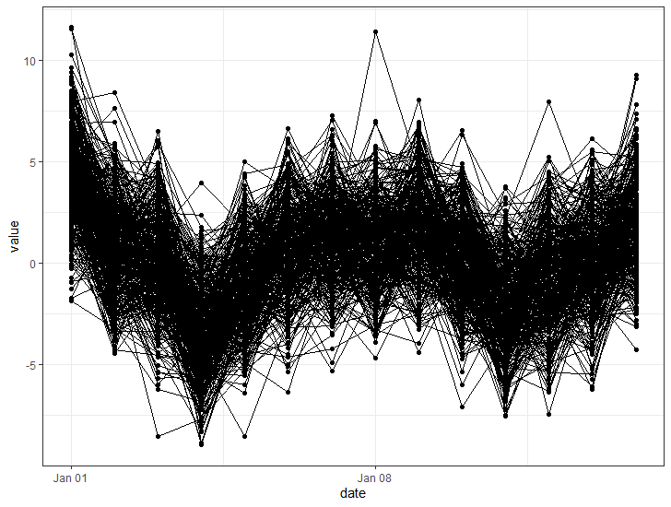
Simulate spatio-temporal data
truth <- simulate_spacetime(temporal_pattern = time_series, field = spatial_field, pattern_adherence = 10)

Slide 20
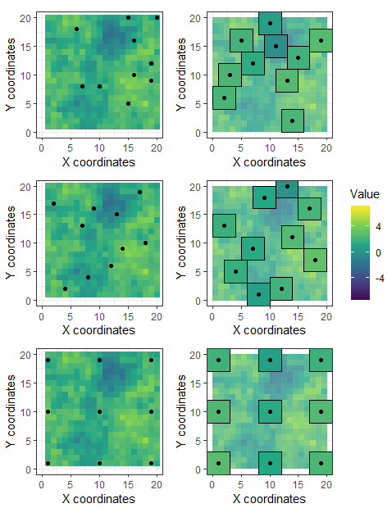
Sampling from the “truth”
Three types of sampling designs
Random sampling where pixels are randomly selected
A "spatially balanced" design, which changes the inclusion probabilities to try to avoid clustering of samples
A regular grid
Random
Balanced
Regular

Slide 21
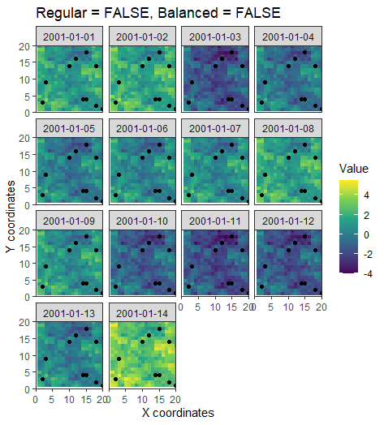
Point sampling
#random sampling point_sample <- sample_area_pointily(field= truth,
n_samples=10,
sampling_error=0.1,
regular = FALSE,
balanced = FALSE)

Slide 22
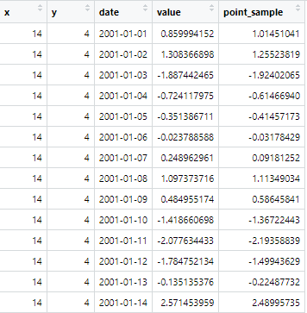
Point sampling
#random sampling point_sample <- sample_area_pointily(field= truth,
n_samples=10,
sampling_error=0.1,
regular = FALSE,
balanced = FALSE)

Slide 23
Point sampling
#random sampling point_sample <- sample_area_pointily(field= truth,
n_samples=10,
sampling_error=0.1,
regular = FALSE,
balanced = FALSE)
“True”
value

Slide 24
Point sampling
#random sampling point_sample <- sample_area_pointily(field= truth,
n_samples=10,
sampling_error=0.1,
regular = FALSE,
balanced = FALSE)
Sampled
value

Slide 25
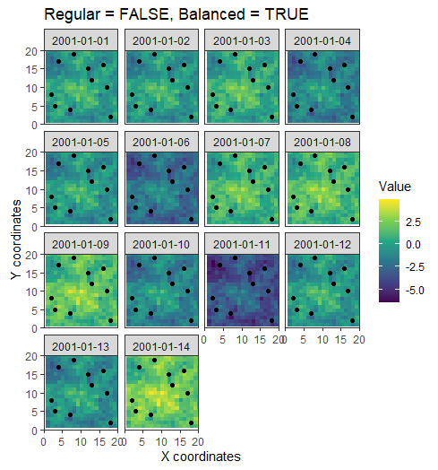
Point sampling
#balanced sampling point_sample <- sample_area_pointily(field= truth,
n_samples=10,
sampling_error=0.1,
regular = FALSE,
balanced = TRUE)

Slide 26
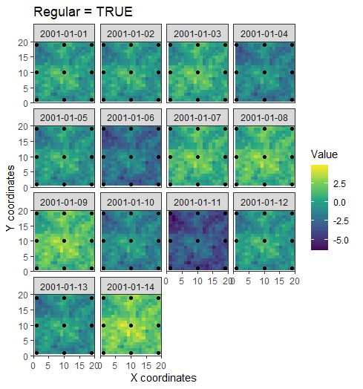
Point sampling
#random sampling point_sample <- sample_area_pointily(field= truth,
n_samples=10,
sampling_error=0.1,
regular = TRUE)

Slide 27
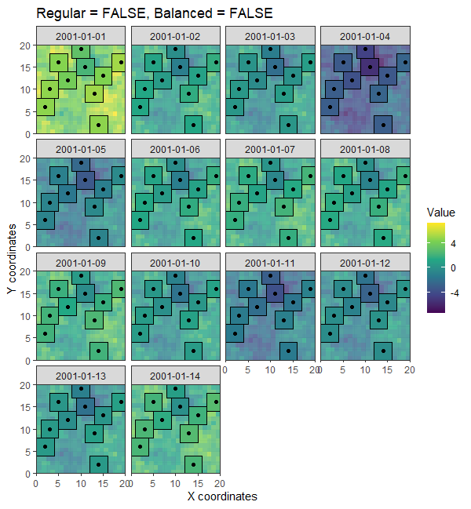
Areal sampling
#random areal sampling area_sample <- sample_area_areally(field=truth,
n_samples =10,
x_range = 2,
y_range = 2,
sampling_error = 0.1,
regular = FALSE,
balanced = FALSE)

Slide 28
Areal sampling
#random areal sampling area_sample <- sample_area_areally(field=truth,
n_samples =10,
x_range = 2,
y_range = 2,
sampling_error = 0.1,
regular = FALSE,
balanced = FALSE)
**To avoid overlap between areas, the centroids are resampled each time areas overlap. Please keep this in mind when selecting the number of points to sample and the area size in relation to the total area.**

Slide 29
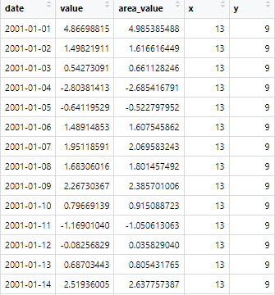
Areal sampling
#random areal sampling area_sample <- sample_area_areally(field=truth,
n_samples =10,
x_range = 2,
y_range = 2,
sampling_error = 0.1,
regular = FALSE,
balanced = FALSE)

Slide 30
Areal sampling
#random areal sampling area_sample <- sample_area_areally(field=truth,
n_samples =10,
x_range = 2,
y_range = 2,
sampling_error = 0.1,
regular = FALSE,
balanced = FALSE)
“True” value
(mean of the area)

Slide 31
Areal sampling
#random areal sampling area_sample <- sample_area_areally(field=truth,
n_samples =10,
x_range = 2,
y_range = 2,
sampling_error = 0.1,
regular = FALSE,
balanced = FALSE)
Sampled value

Slide 32
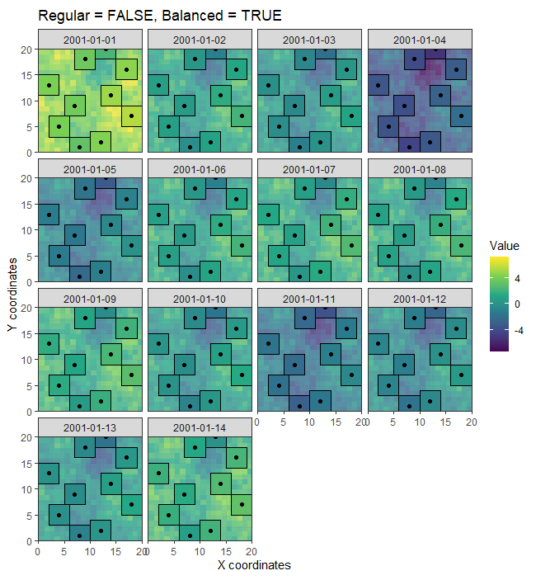
Areal sampling
#balanced areal sampling area_sample <- sample_area_areally(field=truth,
n_samples = 10,
x_range = 2,
y_range = 2,
sampling_error = 0.1,
regular = FALSE,
balanced = TRUE)

Slide 33
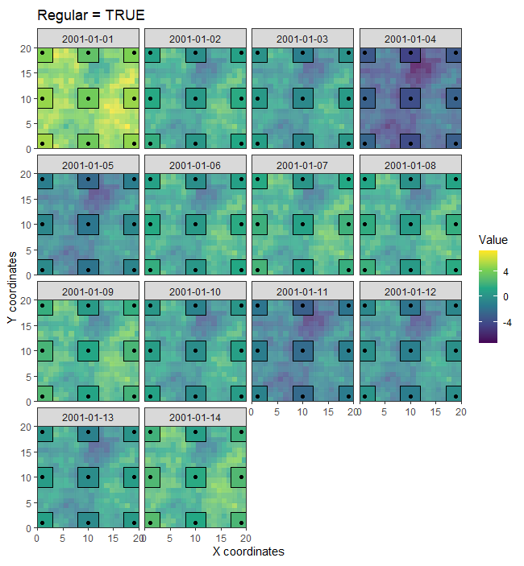
Areal sampling
#regular areal sampling area_sample <- sample_area_areally(field=truth,
n_samples =10,
x_range = 2,
y_range = 2,
sampling_error = 0.1,
regular = TRUE)

Slide 34
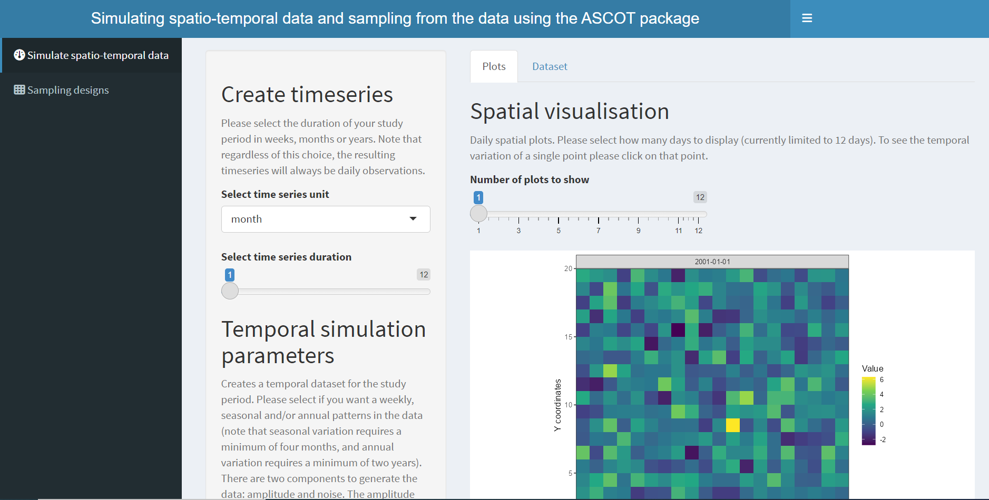
Shiny app

Slide 35
Question?

